Slide 1
Multimodal Media Retrieval and Captioning System
Group - 22
CH V S Adithya
Harini Pradeep Kumar
Madhuri Gupta
Sravan Kumar
Project Mentor: Sheshadri
Project Supervisor: Vineet Gandhi

Slide 2
Agenda
Problem Statement of Image Caption Retrieval
Datasets
Image Caption Retrieval
Model Explored
Results
Image Caption Generation
Data Pre-processing
Model Architecture
Model Explored
Evaluation Metrics
Key Learnings
Challenges
Future Direction
Model Deployment
Contribution

Slide 3
Problem Statement
Image Caption Retrieval
The project of Image Caption Retrieval focuses on developing multi modal network that can retrieve relevant images based on textual descriptions and generate accurate captions for images. The challenge is to effectively understand and link visual content with natural language, ensuring semantic accuracy and contextual relevance.
Image Caption Generation
Project of Caption generation focuses to develop a system that can generate a natural language description of an image by analyzing its visual content, effectively translating the image's meaning into a coherent sentence.
Encoder: Converts the input image into visual feature using ResNet50 CNN / CLIP.
Decoder: Generates a caption word-by-word based on the extracted features using LSTM RNN.

Slide 4
Datasets
Flickr 8K
Number of images: 8091
Number of Captions: Each image is associated with 5 captions, resulting in a total of 40,455 captions.
Total Size of the dataset: Approximately 1.04 GB
Source Link:
https://github.com/jbrownlee/Datasets/releases/download/Flickr8k/Flickr8k_Dataset.zip
https://github.com/jbrownlee/Datasets/releases/download/Flickr8k/Flickr8k_text.zip
Flickr 30K
Number of Images: 31,783
Number of Captions: Each image is associated with 5 captions, resulting in a total of 158,915 captions.
Total Size of the dataset : Approximately 4.12 GB
Source Link:
https://www.kaggle.com/datasets/eeshawn/flickr30k
https://github.com/awsaf49/flickr- dataset/releases/download/v1.0/flickr30k_part00
https://github.com/awsaf49/flickr- dataset/releases/download/v1.0/flickr30k_part01
https://github.com/awsaf49/flickr- dataset/releases/download/v1.0/flickr30k_part02

Slide 5

Image Caption Retrieval

Slide 6
Models Explored
Pretrained CLIP Architecture
CLIP Training from Scratch
Objective Function of CLIP
The objective is to maximize the similarity between the correct (image, text) pairs while minimizing the similarity between incorrect pairs, The model uses a contrastive loss function to achieve this. Both the image and text encoders learn to map their inputs to a shared embedding space where similar images and text descriptions are close to each other.

Slide 7
Pretrained CLIP Architecture
CLIP: Contrastive Language-Image Pre-Training
Developed by OpenAI to bridge the gap between images and natural language descriptions.
Key Features:
Learns visual concepts from text descriptions.
Aligns images and text in a shared embedding space.
Computes similarity scores between image and text embeddings.
Main Components:
Image Encoder:
Uses Vision Transformer (ViT) to convert images into high-dimensional vectors.
Images are divided into patches, processed through 12 transformer layers, with 768 hidden dimensions and 12 attention heads.
Text Encoder:
Based on Transformer architecture to encode text into high-dimensional vectors.
Text is tokenized and processed through multiple layers of masked self-attention.
Enabling powerful cross-modal understanding for advanced AI applications.

Slide 8
CLIP Training from Scratch(1/3)
Image Encoder:
ResNet50 is a deep Convolutional Neural Network (CNN) used for image processing, consisting of 50 layers. It uses residual connections to help train very deep networks without the vanishing gradient problem.
Number of Trainable Parameters: 25.6 million parameters
Text Encoder:
DistilBERT is a smaller, distilled version of BERT, retaining 97% of BERT's performance while being more efficient. It uses 6 transformer layers (instead of 12 in BERT) and has a 768 hidden dimension with 12 attention heads.
Number of Trainable parameters: 66 million parameters.

Slide 9
CLIP Training from Scratch(2/3)
Loss Function
Utilizes contrastive loss to optimize image-text alignment.
Maximizes cosine similarity for correct image-text pairs (positive pairs).
Minimizes cosine similarity for incorrect image-text pairs (negative pairs).
Computes cosine similarity between image and text embeddings.
Aligns embeddings in a shared representation space.
Encourages the model to learn meaningful associations between images and text.
Enables tasks like image search and zero-shot classification.

Slide 10
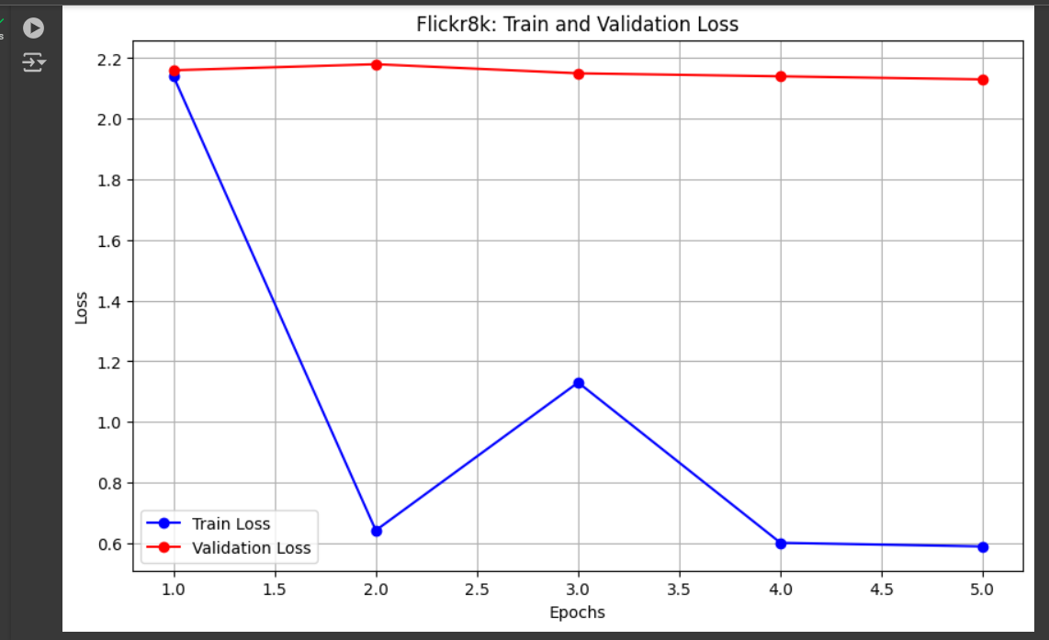
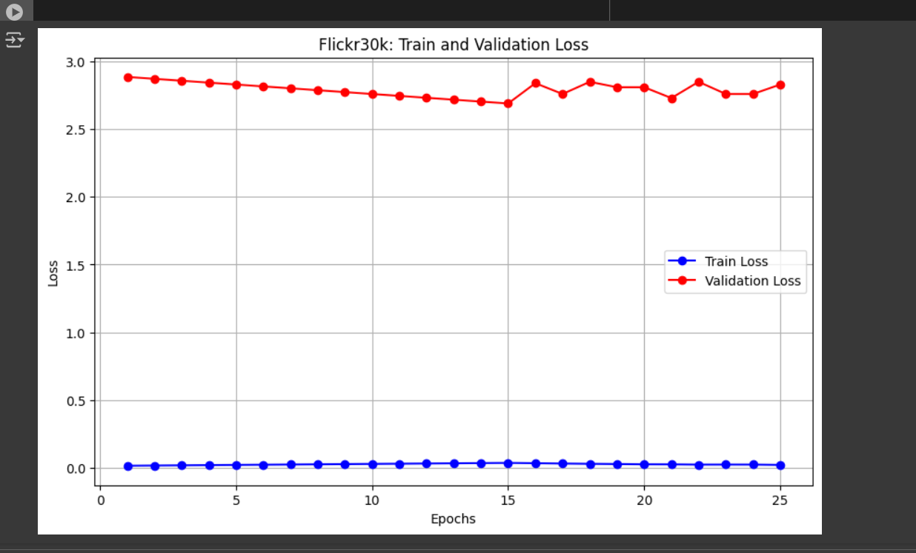
Model Training(3/3)
Number of Epochs Trained: Learning Rate: 0.001
Flickr 8K: 20 epochs
Flickr 30K: 10 epochs
GPU Used: T4
Batch Size: 32
Learning Rate: 0.001
Optimizer: Adam
Time Taken for 1 Iteration/1 Epoch in seconds/minutes:
8k Data set: 7 minutes 54 seconds
30k Data set: 30 minutes 27
Train & Val Loss Graph for Flickr 8K
Train & Val Loss Graph for Flickr 30K

Slide 11
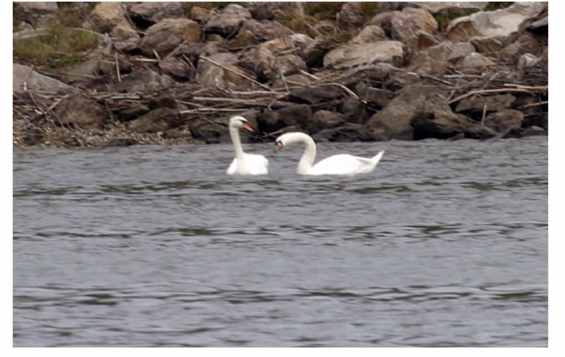
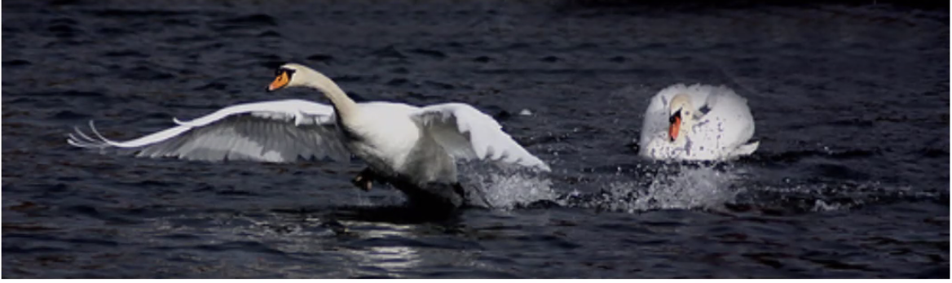
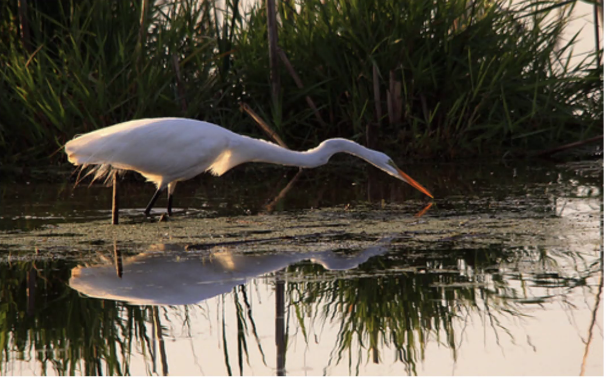
Qualitative Results from Pretrained Clip
Retrieval Type | Actual Data | Retrieved Data
Image to Caption |  | Two swans glide on river.
Text to Image | Two swans glide on river.
Image to Image

Slide 12
Quantitative Results: Retrieval Scores Comparison
Flickr 8K | Pretrained CLIP (Retrieval Accuracy) | Trained CLIP from Scratch (Retrieval Accuracy)
Text2Image | 33% | 22%
Image2Text | 36% | 42%
Text2Text | 99% | 99%
Flickr 30K | Pretrained CLIP (Retrieval Accuracy) | Trained CLIP from Scratch (Retrieval Accuracy)
Text2Image | 34% | 57%
Image2Text | 36% | 37.9%
Text2Text | 99% | 86%

Slide 13
Image Caption Generation

Slide 14
Data Pre Processing
Train-Validation-Test split ratio is 70:20:10.
Images are resized to 224 x 224 x 3 dimension, coloured and are converted to tensors.
Captions are cleaned and tokenized using spaCy.
Vocabulary building.
Mapping captions to numerical IDs.
Caption | Tokenized | Numericalized
“a dog running” | [<SOS>,”a”,”dog”,”running”,<EOS>] | [100,1,2,3,101,<PAD>,<PAD>]
“a boy playing soccer in the park” | [<SOS>,”a”,”boy”,”playing”,”soccer”,”in”,”the”,”park”,<EOS>] | [100,1,4,6,7,8,9,101]

Slide 15
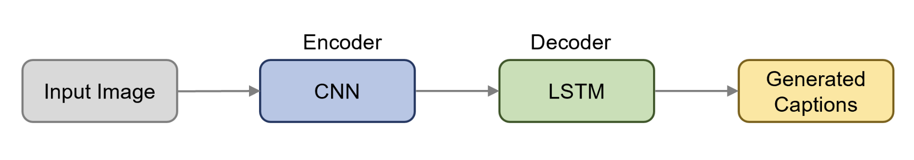
Model Architecture - Caption Generation
Encoder: Convolutional Neural Networks (CNN) - ResNet50/CLIP is used to extract the features from the image.
Decoder: Long short-term memory (LSTM) with multi-head attention model used to caption the image based on features extracted from the encoder.

Slide 16
Models Explored
Resnet - LSTM
Image features extracted using a RESNET CNN encoder.
Captions generated using an LSTM decoder.
CLIP - LSTM
Features extracted using the CLIP encoder.
Captions generated using an LSTM decoder.
CLIP - LSTM with Attention
Features extracted using the CLIP encoder.
Captions generated using an LSTM decoder with additional multi head attention layer.
VIT - GPT2
Features extracted using the VIT encoder.
Captions generated using an GPT2 decoder.

Slide 17
Resnet - LSTM
Model Training Parameters
Resnet feature vector size - 512
LSTM Hidden size - 512
Number of LSTM layers - 3
Optimizer - Adam
Learning rate - 0.0001
Loss function - Cross entropy
Number of epochs - 20
Test Results after 20 epochs for 8k Model:
Evaluation metric: BLEU2: 0.32, BLEU3: 0.15 & BLEU4: 0.07, WER: 0.76, Rouge 1: 0.43, Rouge 2: 0.19, Rouge L: 0.40
Similarity Score: 0.46
Test Results after 20 epochs for 30K Model:
Evaluation metric: BLEU2: 0.34, BLEU3: 0.17, BLEU4: 0.08, WER: 0.78, Rouge 1: 0.43, Rouge 2: 0.19, Rouge L: 0.39
Similarity Score: 0.53

Slide 18
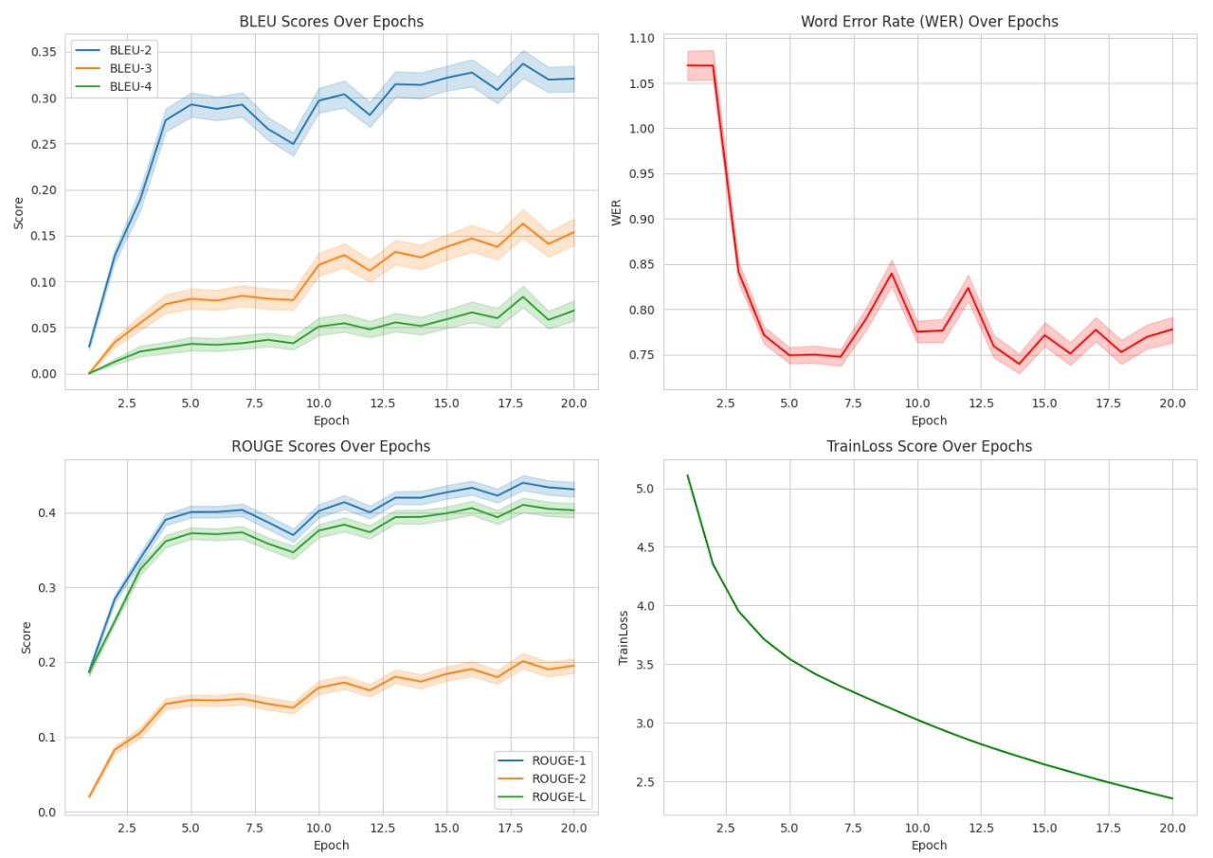
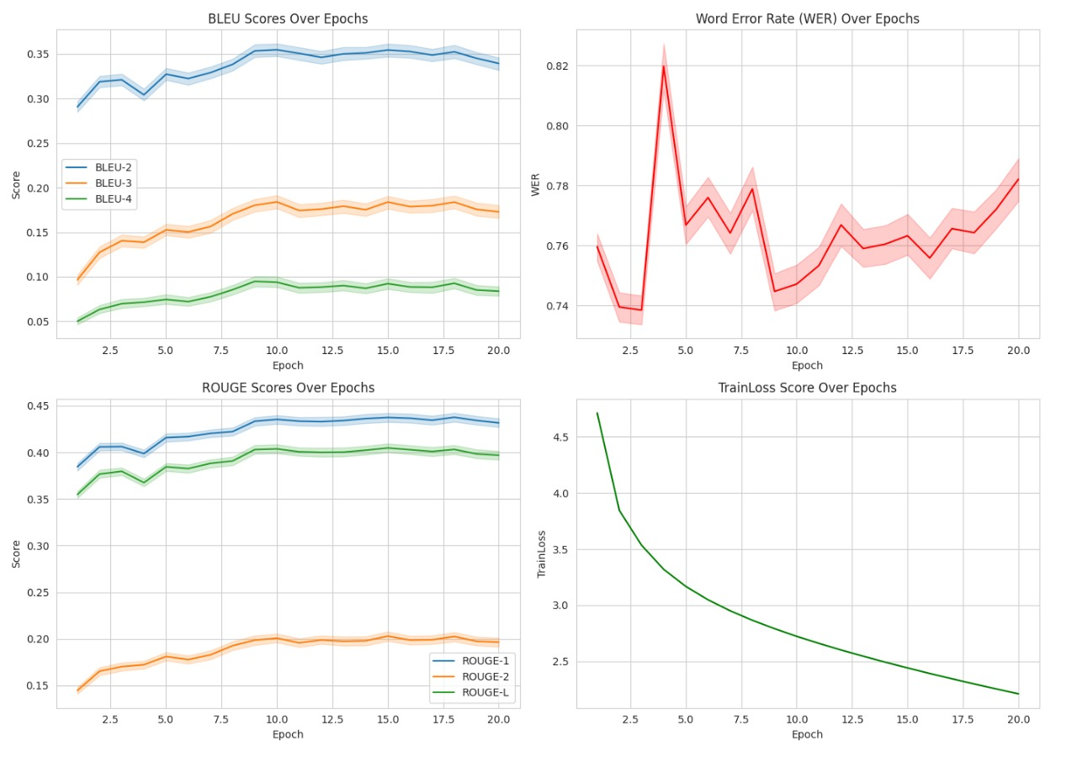
Train Scores
8K Results
30K Results

Slide 19
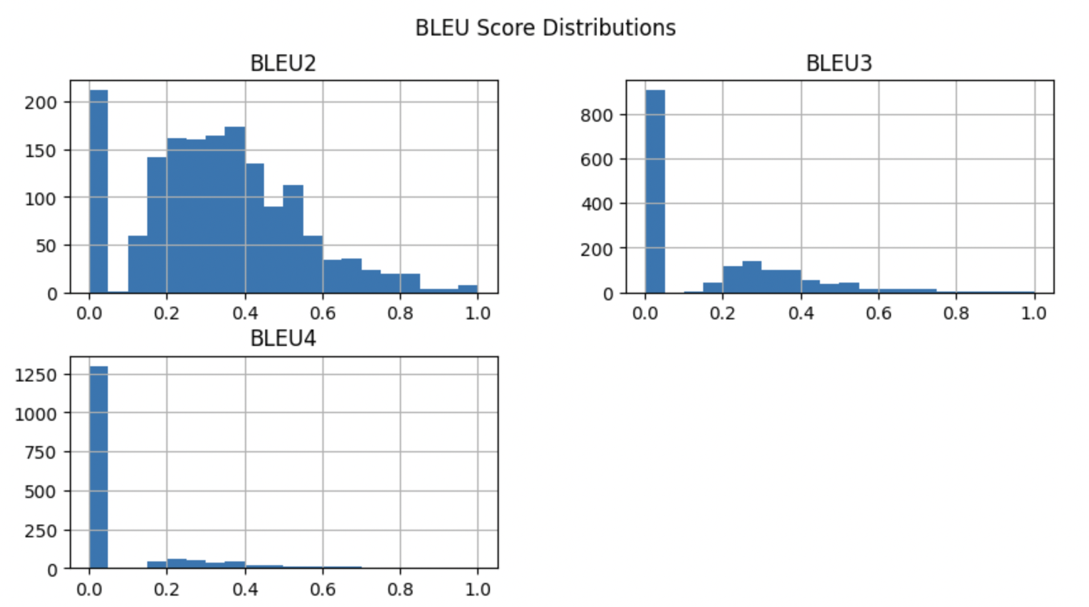
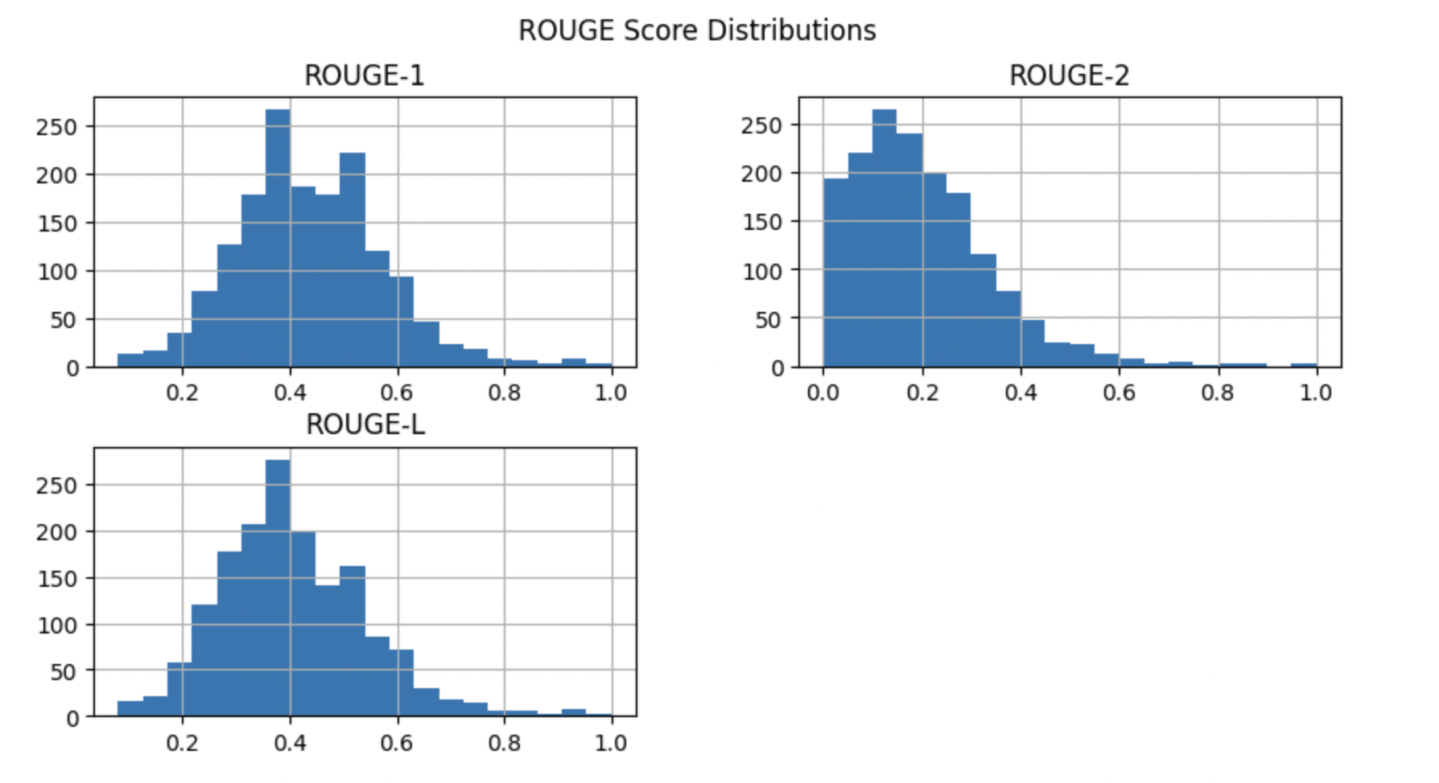
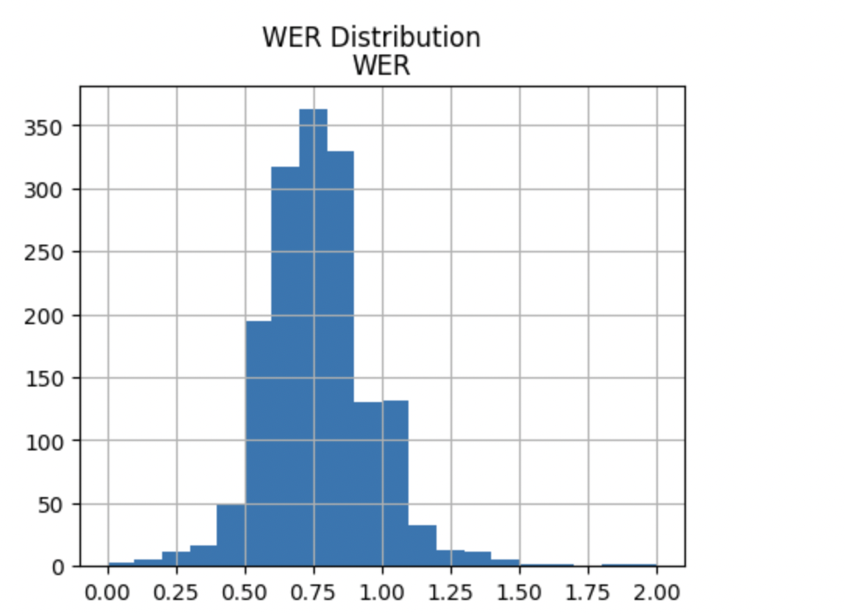
8k Test Scores

Slide 20
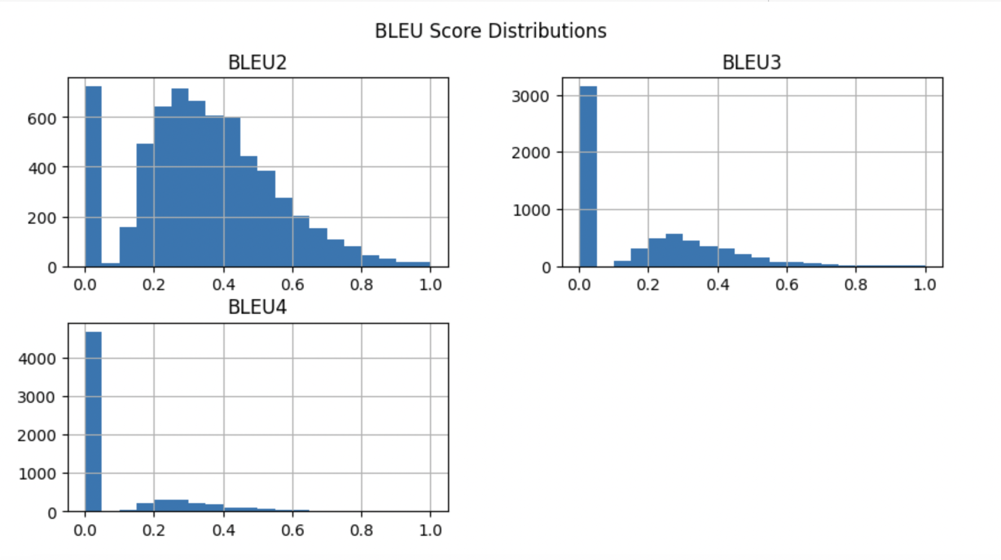
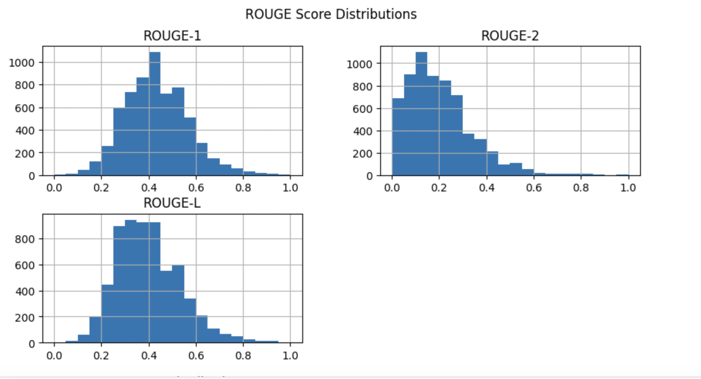
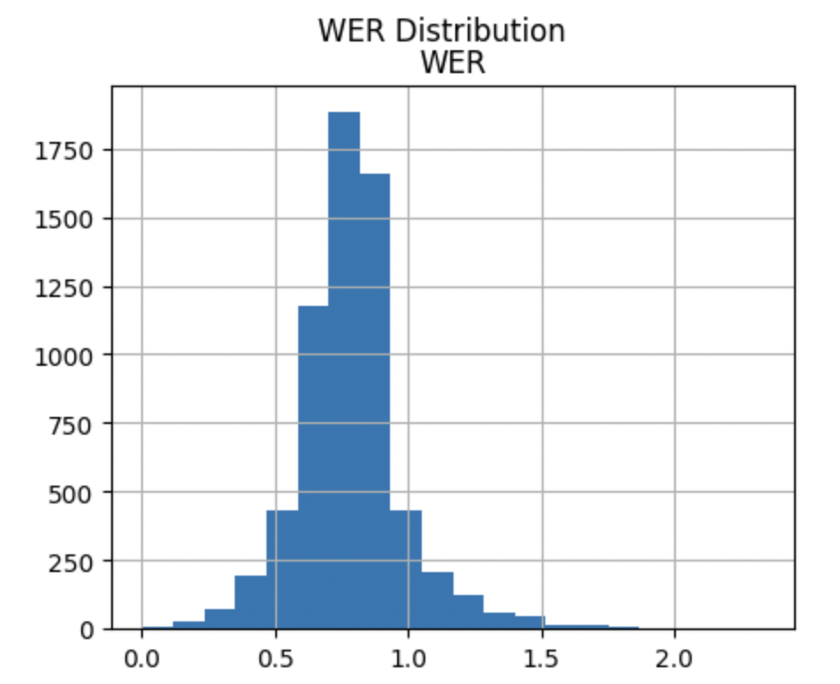
30k Test Scores

Slide 21
CLIP - LSTM
Model Training Parameters
Clip feature vector size - 512
LSTM Hidden size - 512
Number of LSTM layers - 3
Optimizer - Adam
Learning rate - 0.0001
Loss function - Cross entropy
Number of epochs - 20
Test Results after 20 epochs for 8k Model:
Evaluation metric: BLEU2: 0.39, BLEU3: 0.19 , BLEU4: 0.08, WER: 0.70, Rouge 1: 0.47, Rouge 2: 0.23, Rouge L: 0.44
Similarity Score: 0.48
Test Results after 20 epochs for 30K Model:
Evaluation metric: BLEU2: 0.44, BLEU3: 0.25, BLEU4: 0.13, WER: 0.69, Rouge 1: 0.49, Rouge 2: 0.25, Rouge L: 0.46
Similarity Score: 0.60

Slide 22
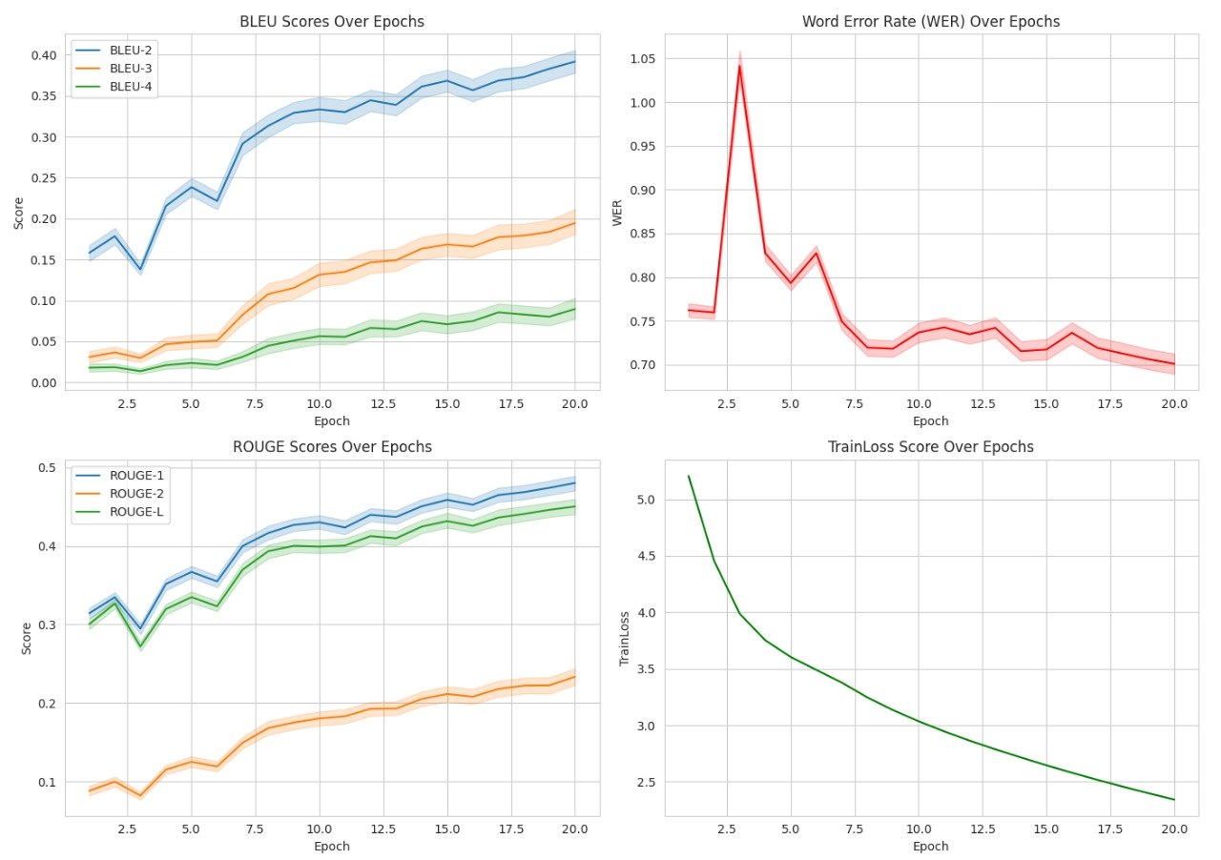
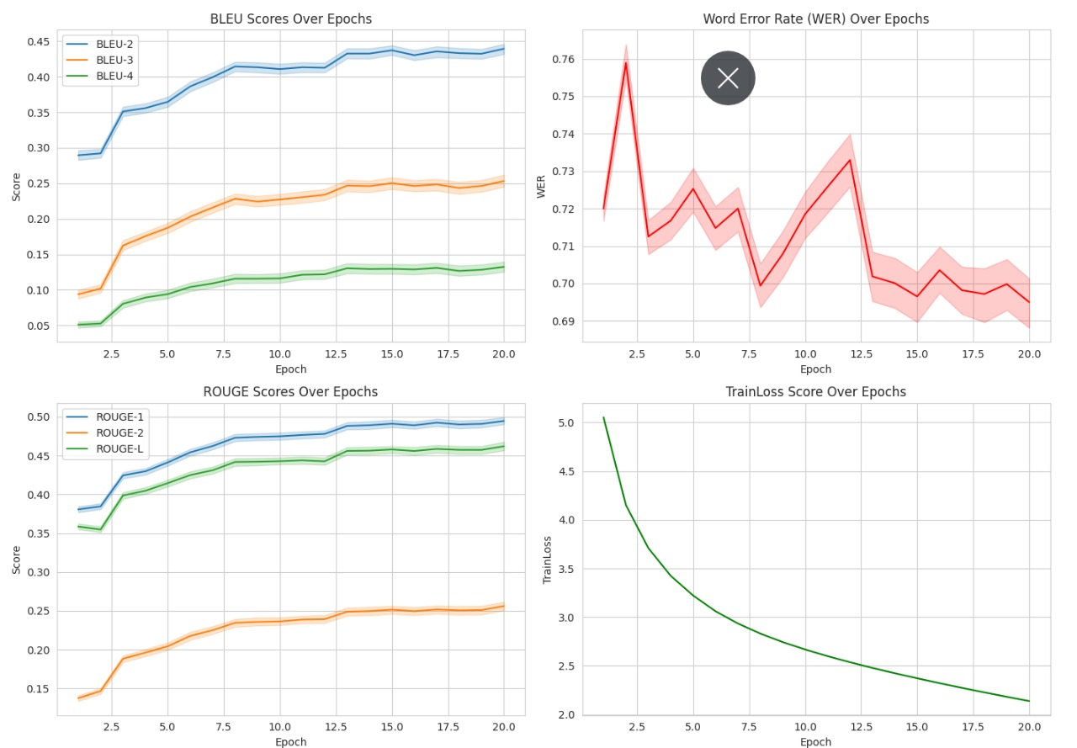
Training Results
8k Train scores
30k Train scores

Slide 23
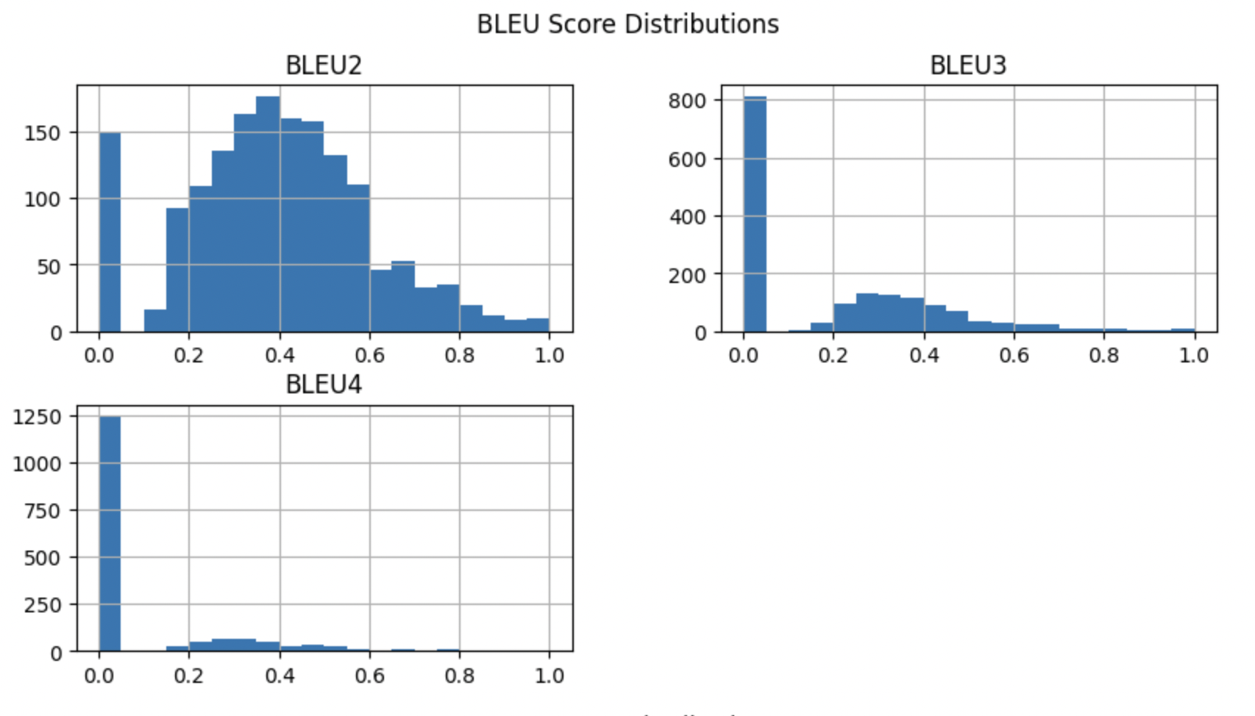
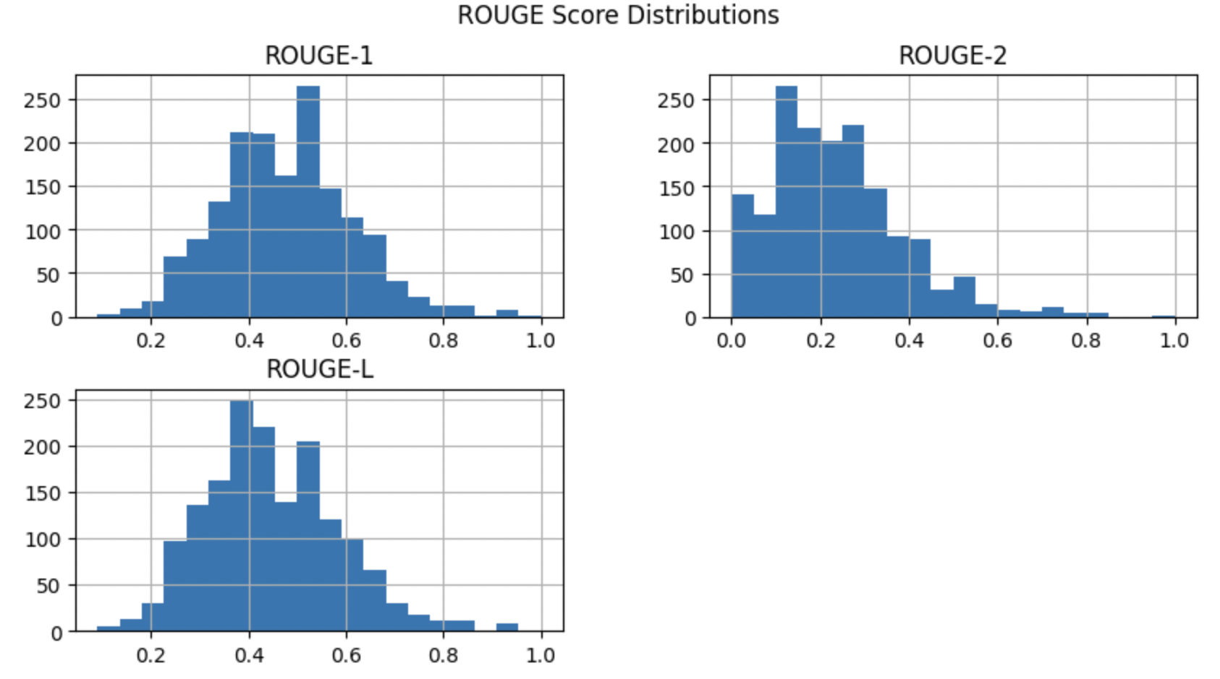
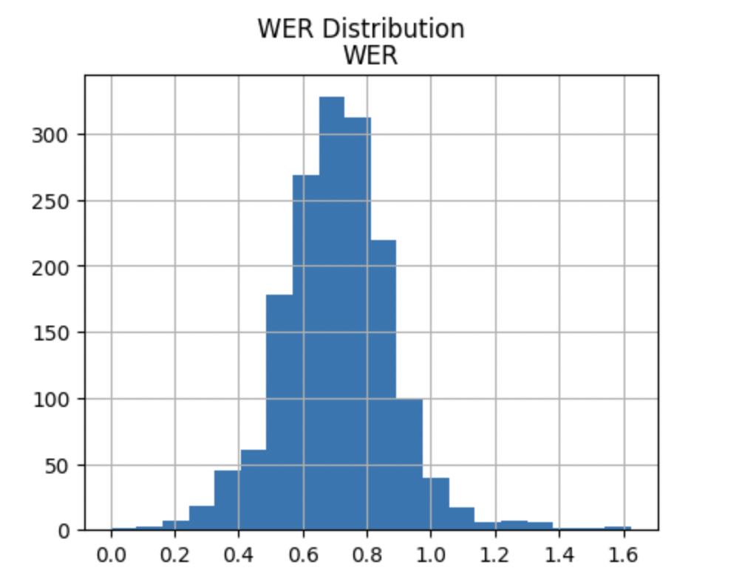
8K Test Scores

Slide 24
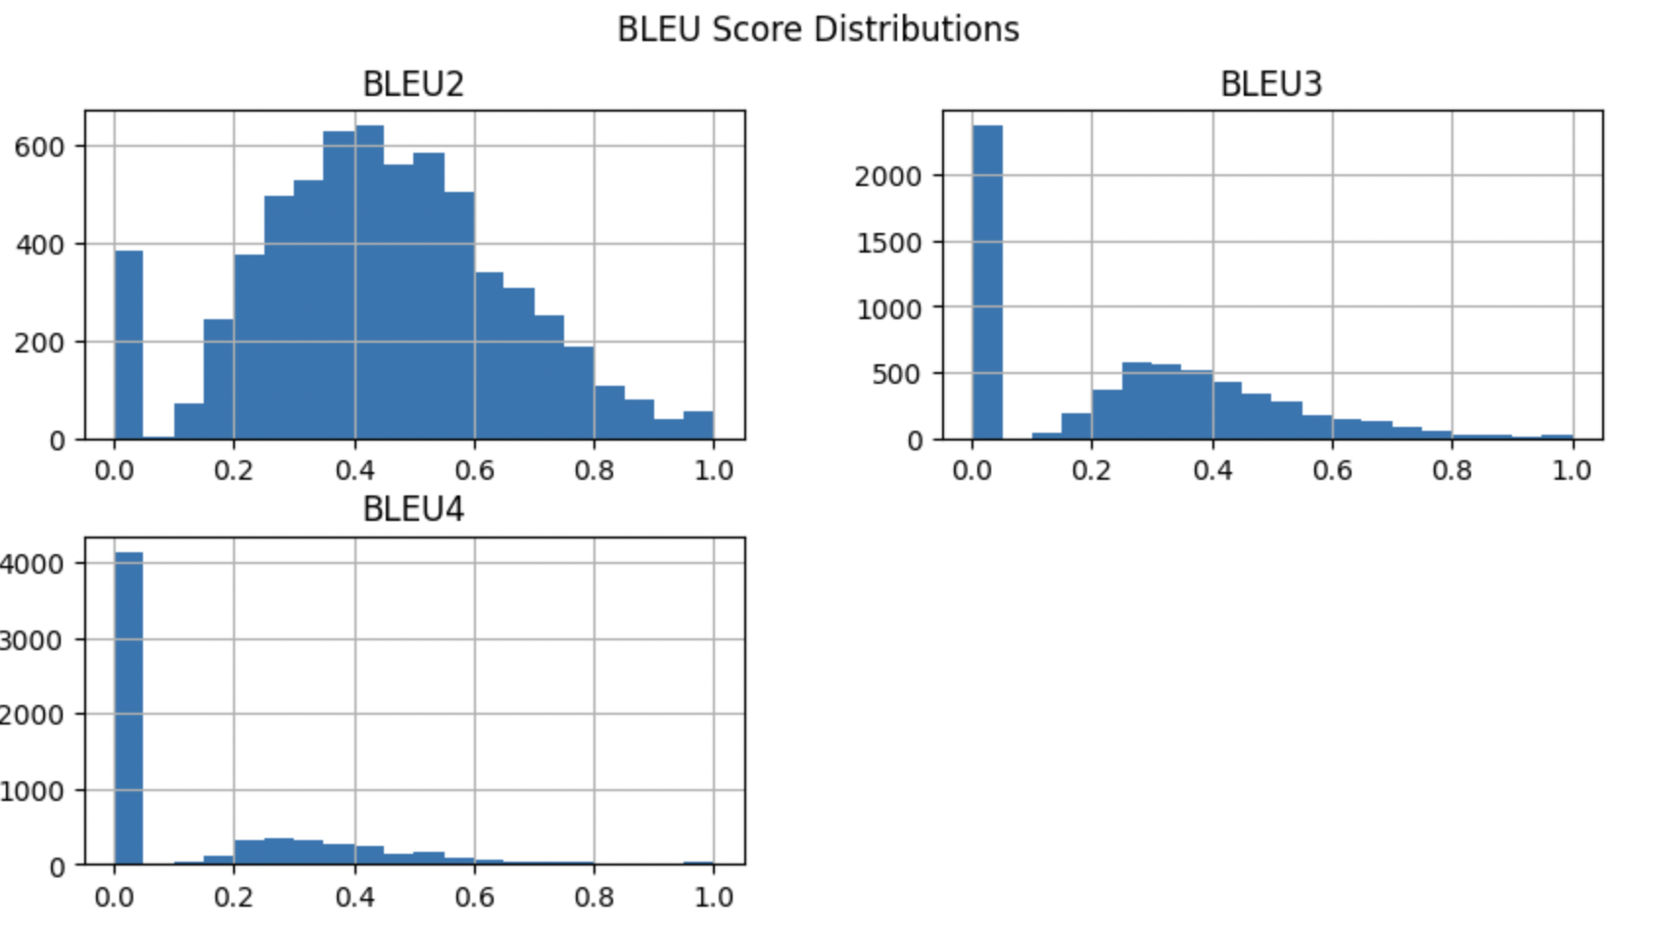
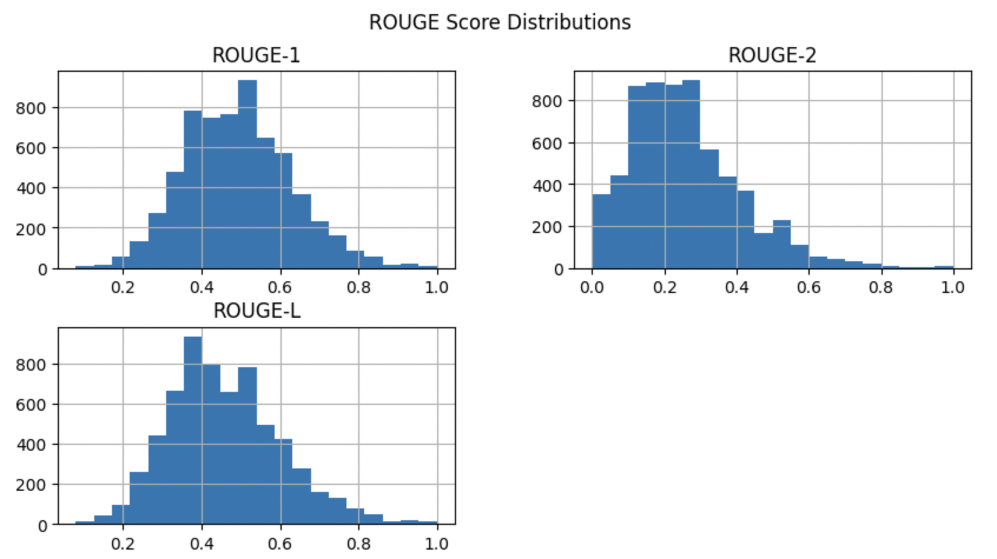
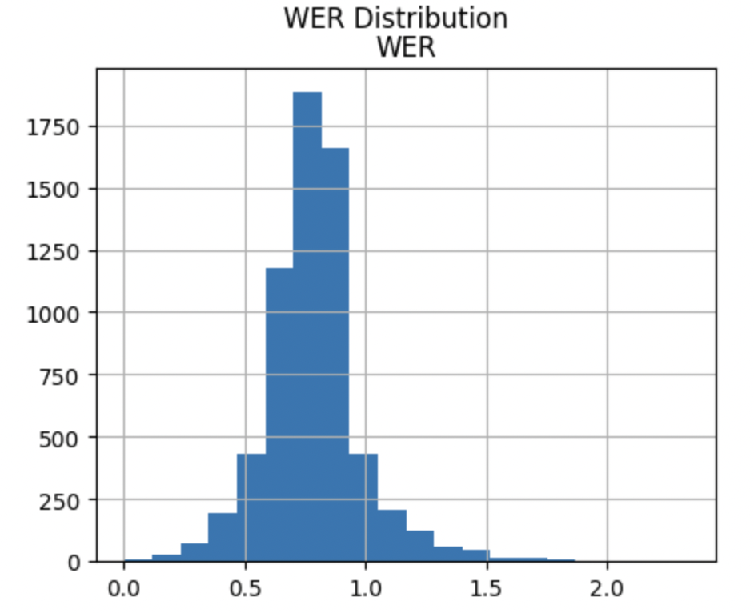
30K Test Scores

Slide 25
CLIP - LSTM with Attention
Model Training Parameters
Clip feature vector size - 512
LSTM Hidden size - 512
Number of Heads - 8
Number of LSTM layers - 3
Optimizer - Adam
Learning rate - 0.0001
Loss function - Cross entropy
Number of epochs - 20
Test Results after 20 epochs for 8k Model:
Evaluation metric: BLEU2: 0.42, BLEU3: 0.23 , BLEU4: 0.11, WER: 0.70, Rouge 1: 0.50, Rouge 2: 0.25, Rouge L: 0.47
Similarity Score: 0.64
Test Results after 20 epochs for 30K Model:
Evaluation metric: BLEU2: 0.43, BLEU3: 0.24, BLEU4: 0.12, WER: 0.70, Rouge 1: 0.48, Rouge 2: 0.24, Rouge L: 0.45
Similarity Score: 0.63

Slide 26
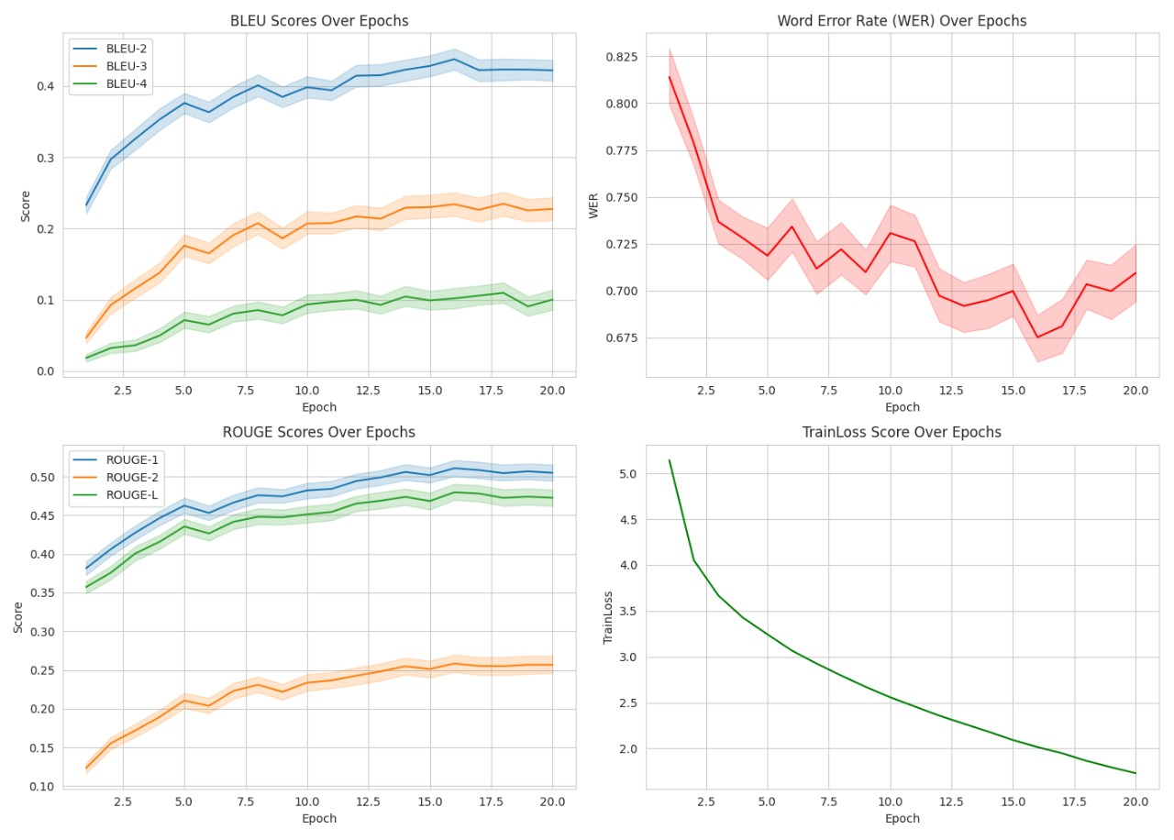
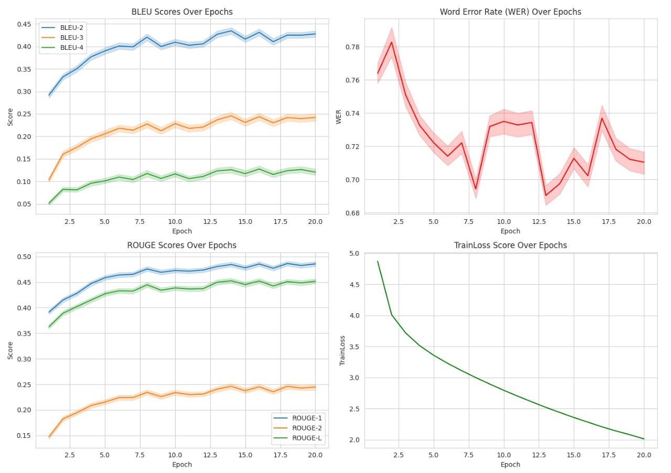
Train Scores
8k Train scores
30k Train scores

Slide 27
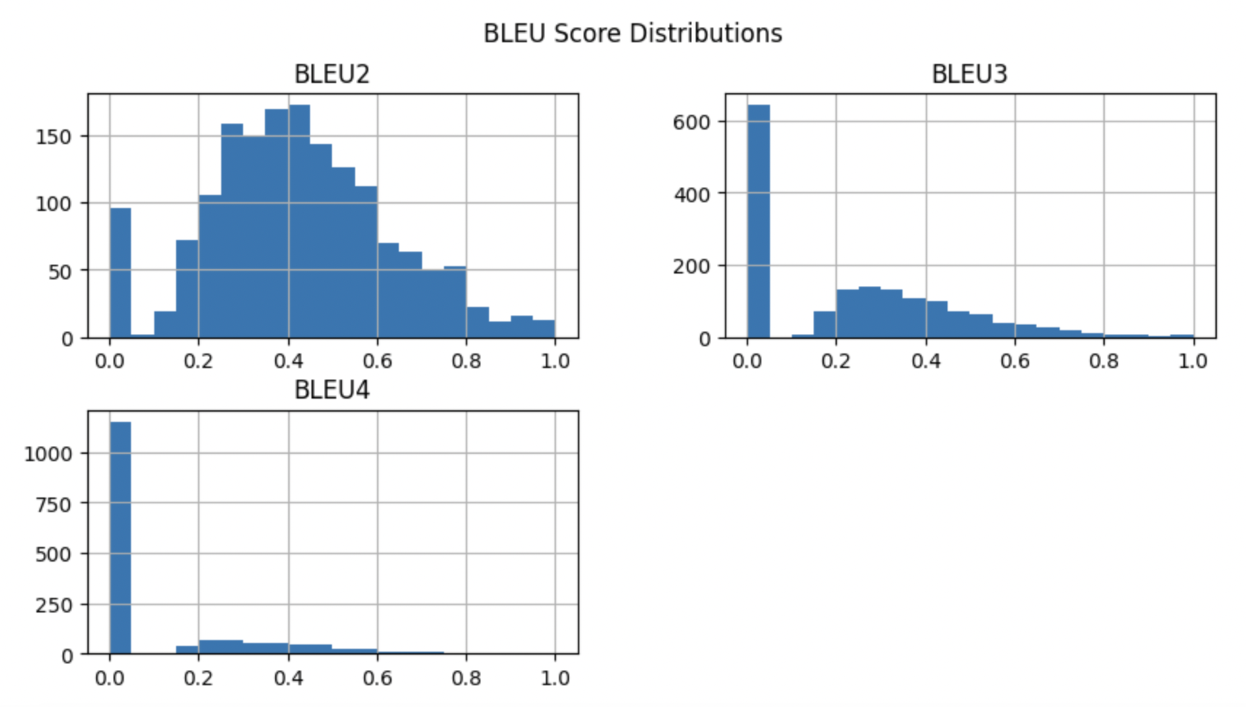
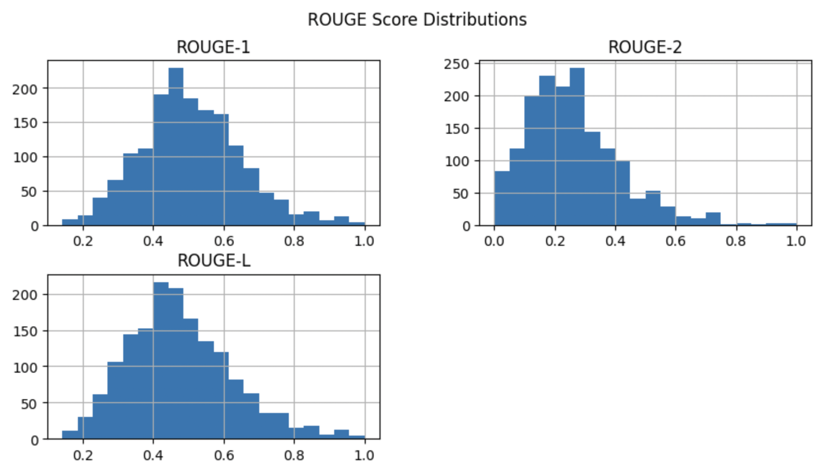
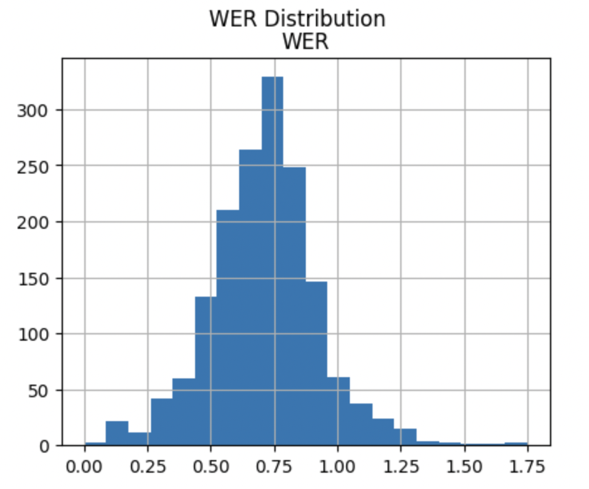
8k Test Scores

Slide 28
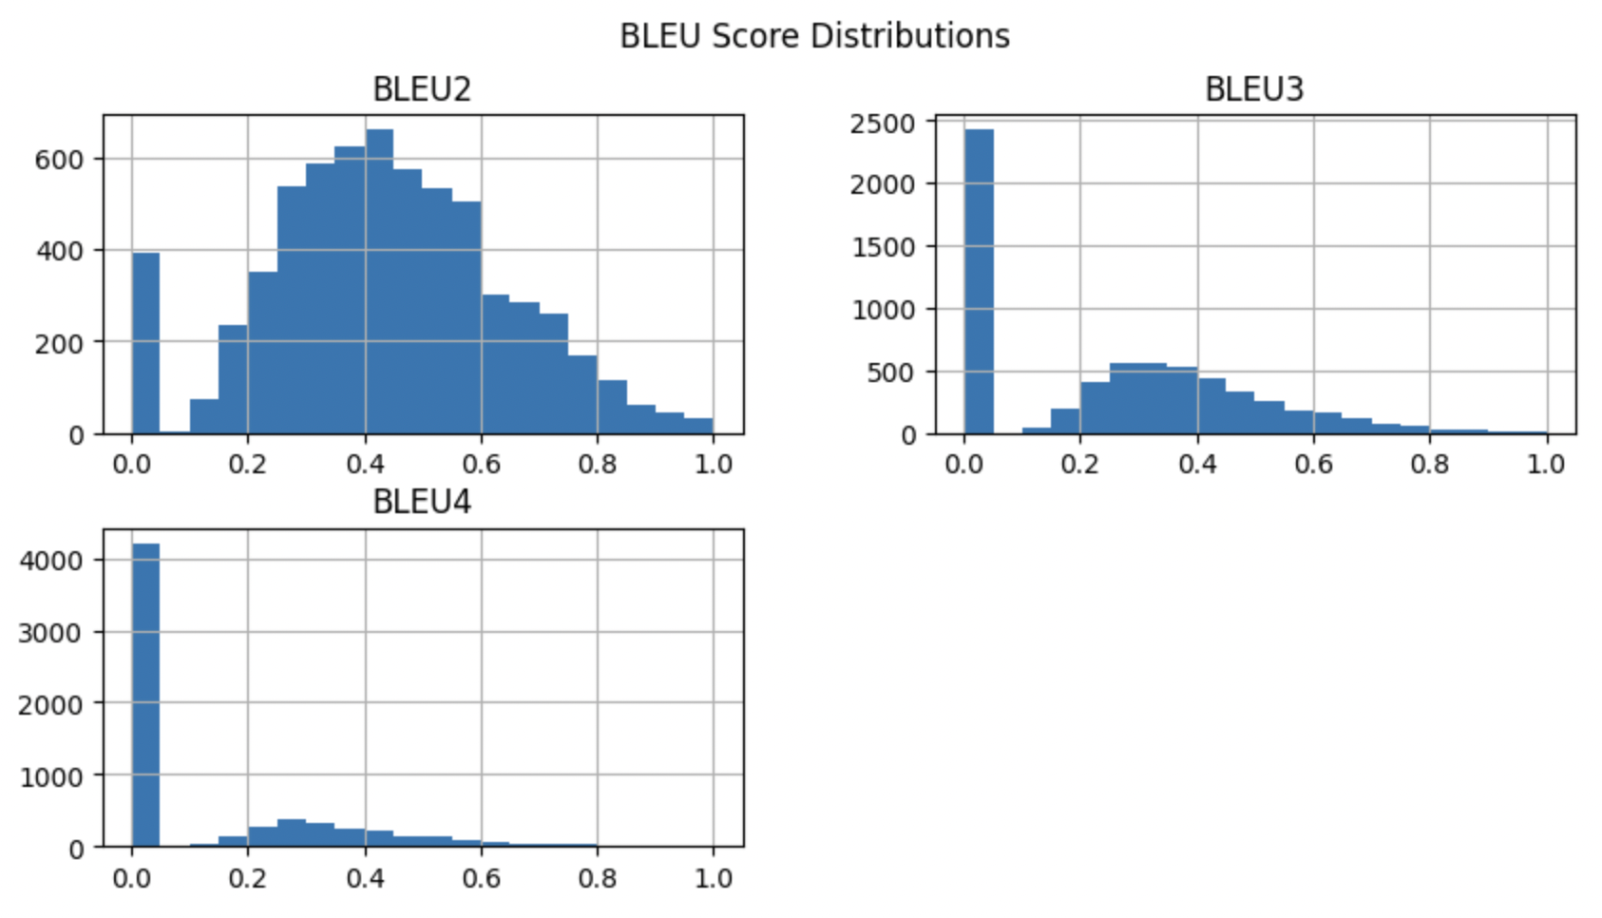
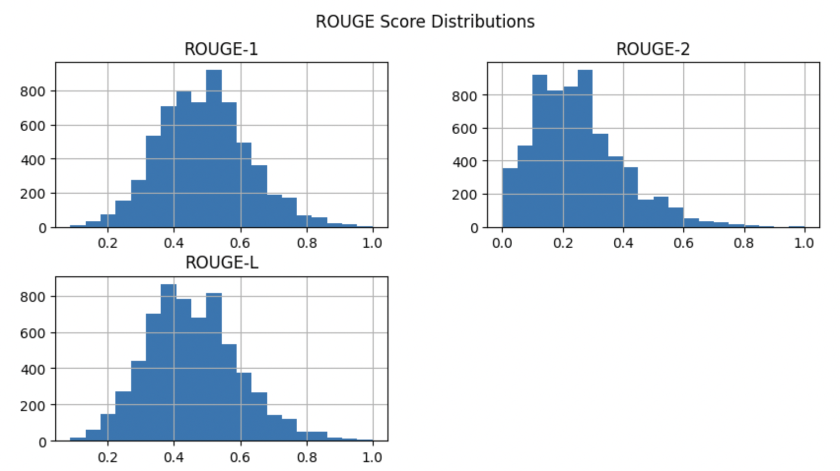
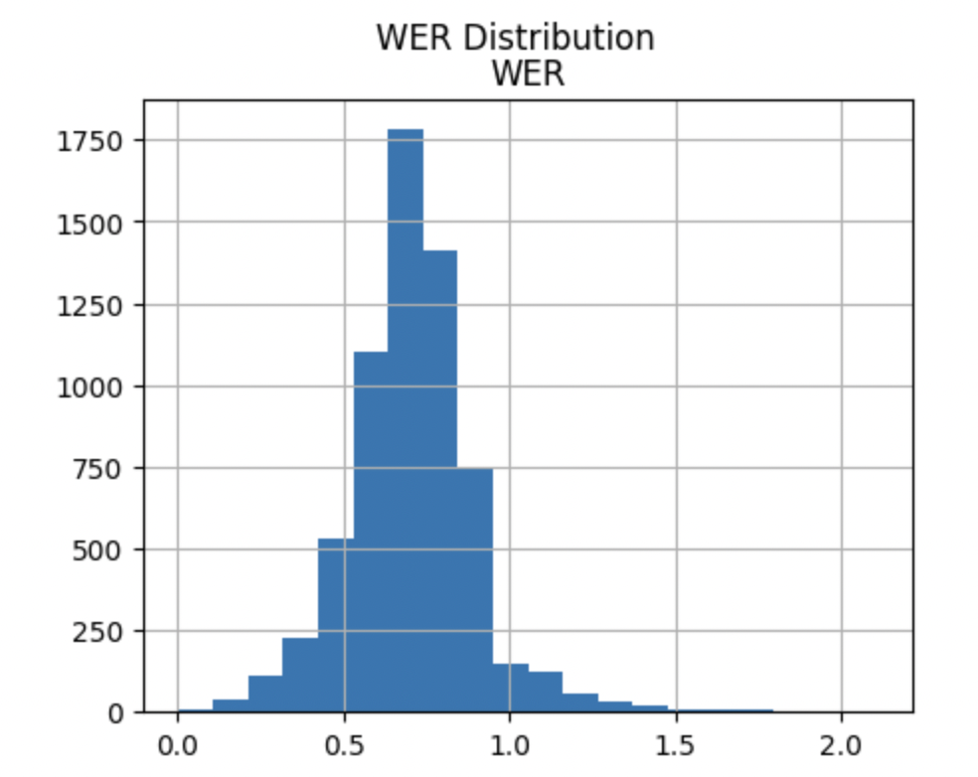
30k Test Scores

Slide 29
Evaluation Metrics
Sl. No. | Metric Score | ResNet50-LSTM-8k | CLIP-LSTM-8k | CLIP-ATTN-8k | ResNet50-LSTM-30k | CLIP-LSTM-30k | CLIP-ATTN-30k
1 | Average BLEU-2 | 0.3286 | 0.3919 | 0.4216 | 0.3421 | 0.4401 | 0.433
2 | Average BLEU-3 | 0.1588 | 0.1954 | 0.2341 | 0.175 | 0.255 | 0.2466
3 | Average BLEU-4 | 0.0708 | 0.0889 | 0.1117 | 0.0871 | 0.1346 | 0.1262
4 | Average WER | 0.7645 | 0.7032 | 0.7098 | 0.7829 | 0.698 | 0.7052
5 | Average ROUGE-1 | 0.4371 | 0.4763 | 0.5048 | 0.4326 | 0.494 | 0.4892
6 | Average ROUGE-2 | 0.1969 | 0.2317 | 0.2586 | 0.1972 | 0.2548 | 0.249
7 | Average ROUGE-L | 0.4078 | 0.4483 | 0.4743 | 0.3973 | 0.4608 | 0.456

Slide 30
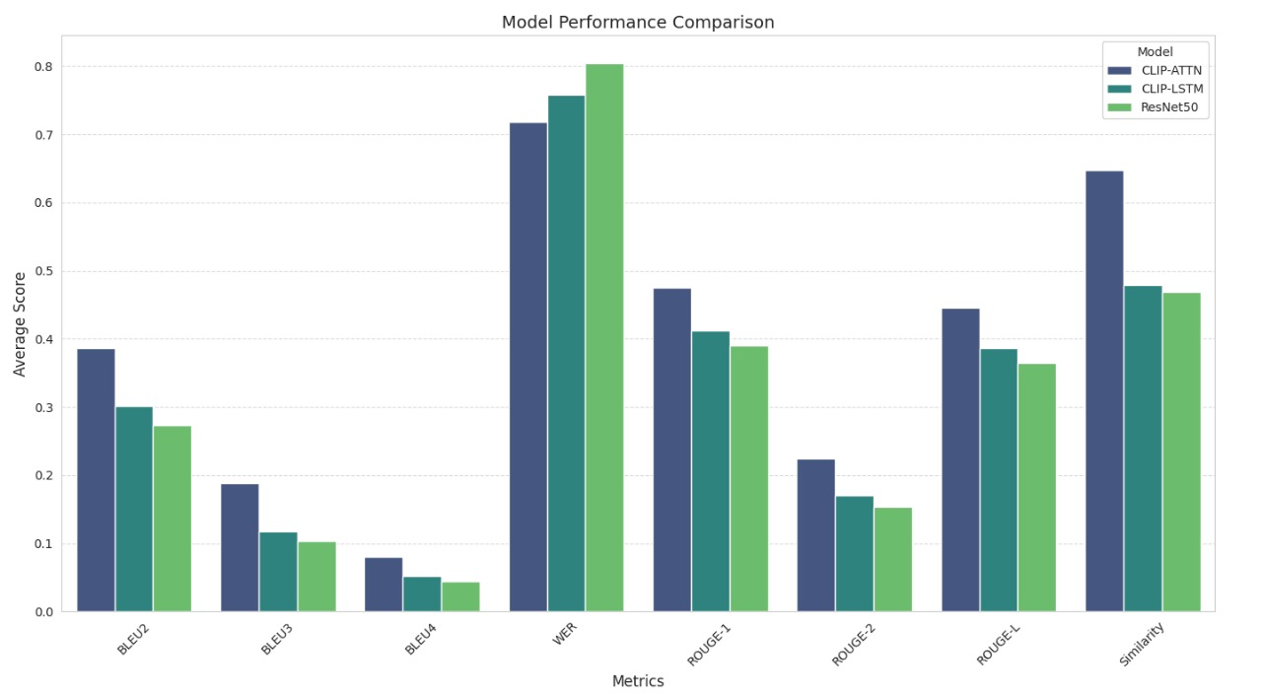
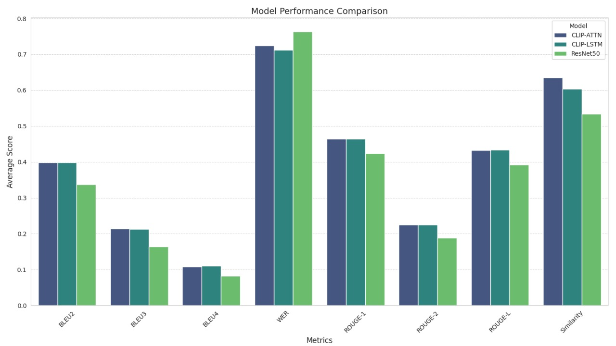
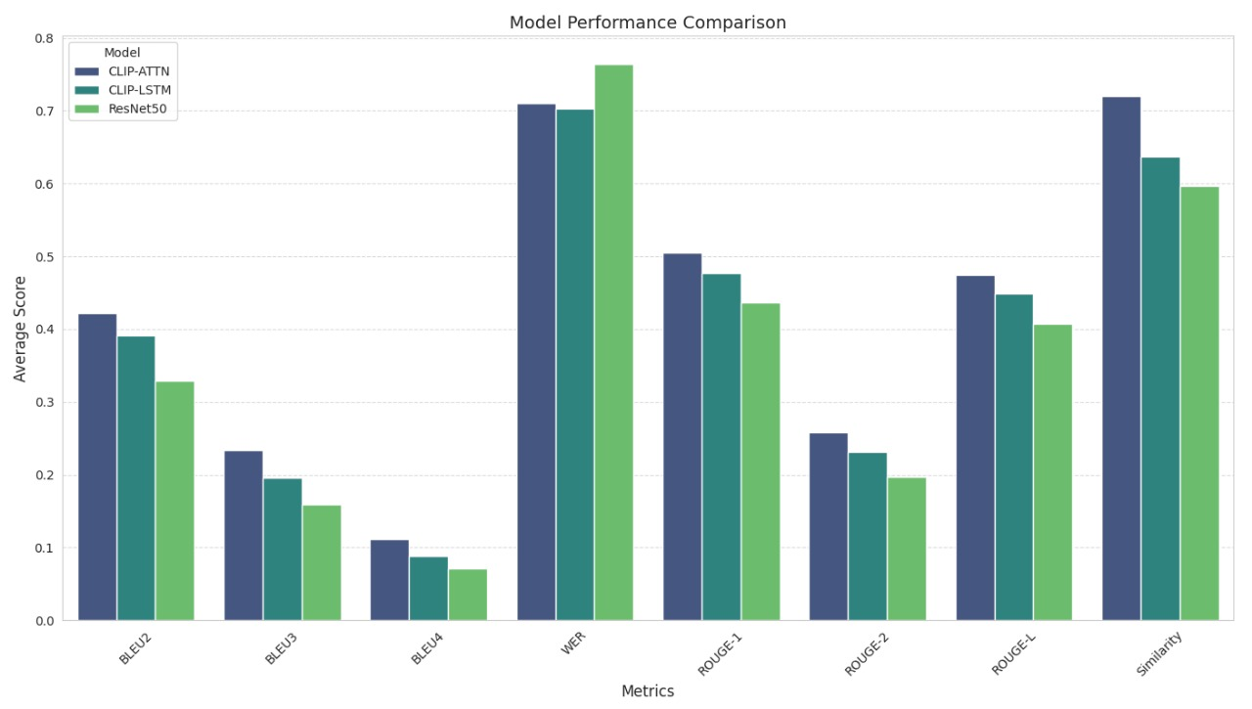
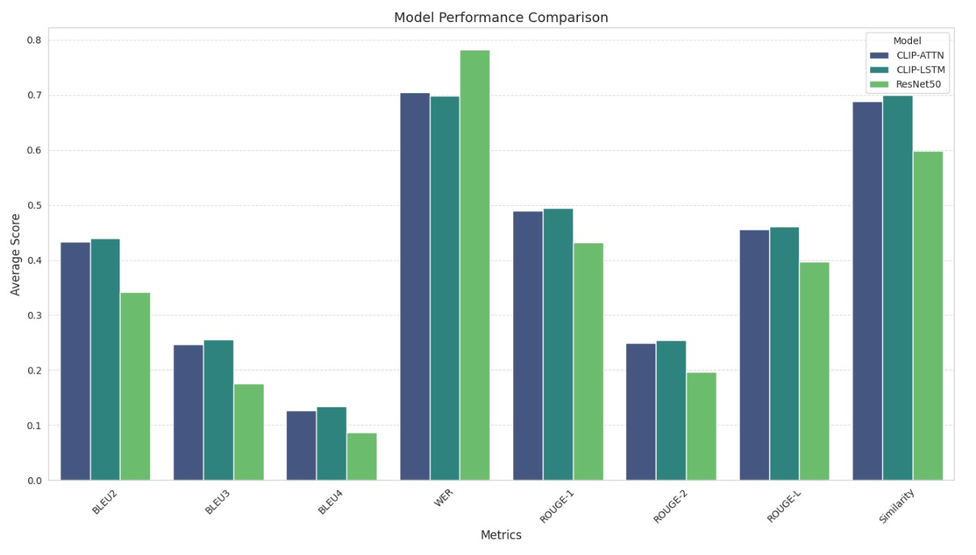
8K Model Train Scores
30K Model Train Scores
8K Model Test Scores
30K Model Test Scores

Slide 31
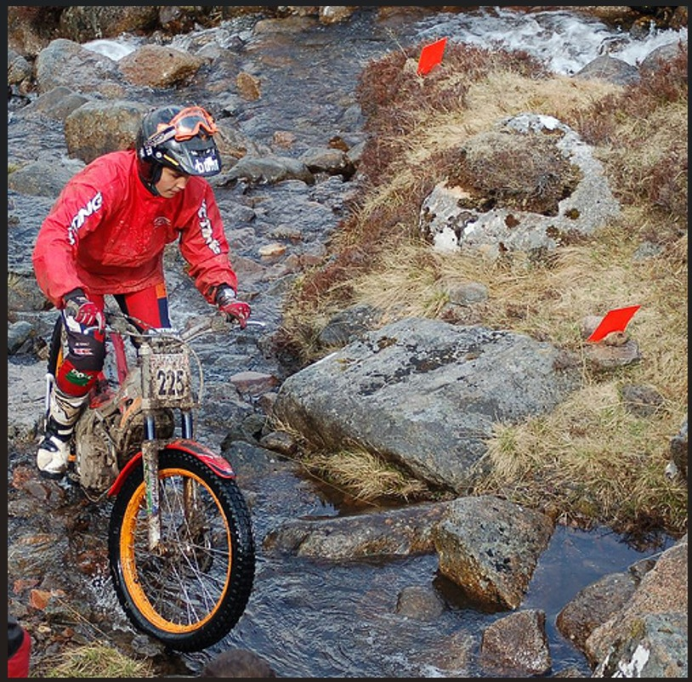
Qualitative Analysis
Image
Actual Caption
1. A boy in a black helmet and red long sleeve shirt rides his motorbike over a rocky stream .
2. A man on a motorcycle steers through swampy terrain
3. A man rides his bike over rocks and a creek.
4. A motocross bike is being ridden between markers in a running stream .
5. A person is dirt biking over rocks and water.
Model | Predicted Caption using 30K
ResNet + LSTM | a man in a red helmet is riding a bike in the woods
CLIP + LSTM | a person in a red helmet is riding a mountain bike
CLIP + LSTM with Attention | a person in a red and white outfit is riding a bike on a dirt trail

Slide 32
Key Learnings
Understanding of Encoder Decoder Architecture.
Evaluating captions effectively using BLEU, ROGUE and WER metrics
Fine-Tuning Can Boost Performance – Pretrained models fine-tuned on domain-specific datasets (e.g., medical, satellite) improve caption accuracy.
Performance Comparison: Based on results of both 8K and 30K CLIP-LSTM with Attention network model performing better.

Slide 33
Challenges
Data Limitations – Requires large datasets like Flickr30k, but domain-specific data (e.g., medical, satellite images) is scarce.
Handling Out-of-Vocabulary (OOV) Words – Captions may contain rare or unseen words, requiring special tokenization or word truncation strategies.
Training Complexity – CLIP-based models and Attention mechanisms increase computational cost, making training resource-intensive.
Evaluation Challenges – Metrics like BLEU, ROUGE, and WER focus on word overlap but struggle to measure semantic correctness.
Overfitting & Generalization – The model may overfit frequent patterns in training data, reducing performance on unseen images.
Real-World Adaptation – Handling ambiguous or multi-object images remains a challenge for accurate captioning.

Slide 34
Future Directions
Multimodal Learning: Integrates text, vision, and audio to deliver context-aware captioning, enhancing AR/VR experiences, robotics, and autonomous systems.
Self-Supervised & Few-Shot Learning: Reduces reliance on extensive labeled datasets through self-supervised pretraining and few-shot adaptation, ideal for low-resource fields like medical imaging.
Efficient Real-Time Inference: Optimizes models for mobile and edge devices using quantization, distillation, and lightweight CNNs, supporting assistive technologies for the visually impaired.
Cross-Lingual & Multilingual Captioning: Enables caption generation in multiple languages, enhancing global accessibility, travel apps, and multilingual content creation.
Automated Content Tagging & Search: Improves media platforms (e.g., YouTube, Instagram, TikTok) with automatic captioning, image indexing, and intelligent search capabilities.
E-commerce & Retail Integration: Enhances visual product search, catalog descriptions, and automated advertising through AI-generated captions.

Slide 35
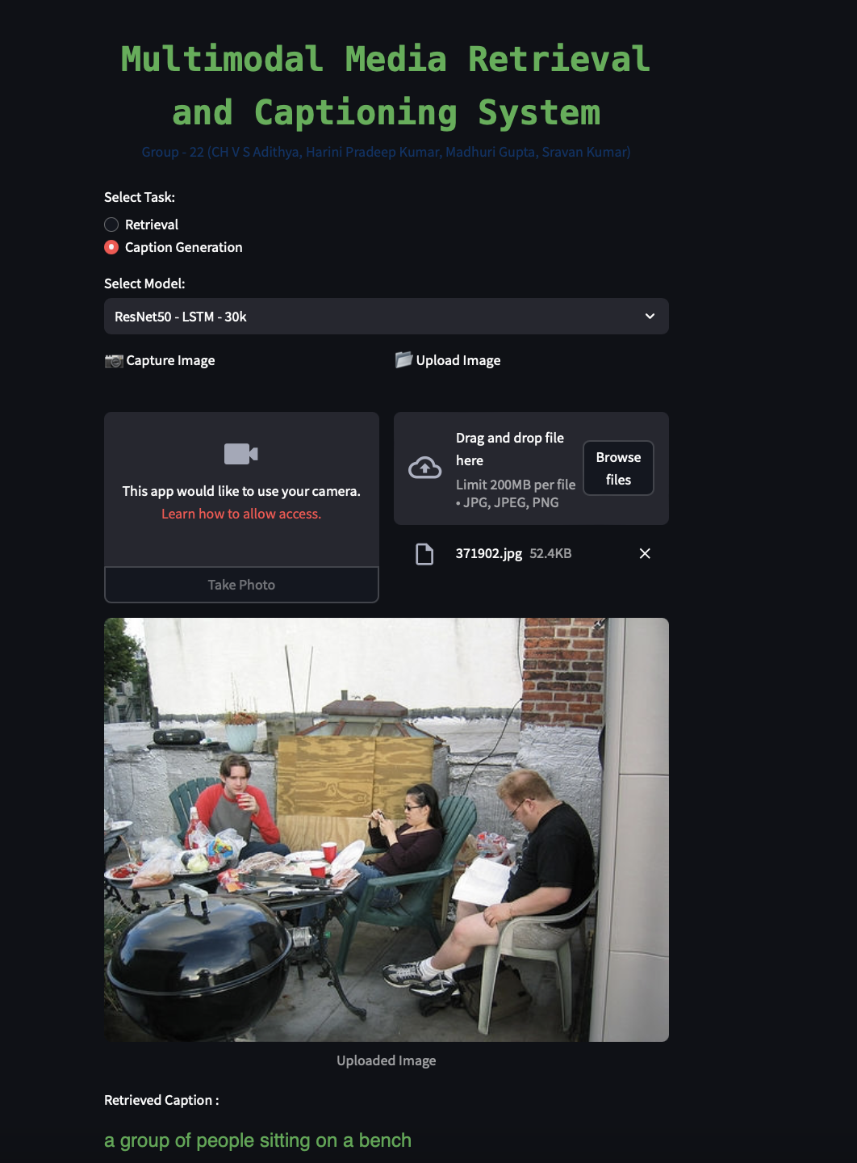
Model Deployment
We have created an interactive Streamlit app for our image retrieval and captioning model. Also, deployed in the Hugging Face and Ngrok.
Github Link:
https://github.com/sravankumarmsb/mmrcg
Demo Link:
http://localhost:8501
https://huggingface.co/spaces/sravankumarmsb/mmrcs
https://bb58-35-229-237-238.ngrok-free.app/

Slide 36
Contribution
Harini and Madhuri: https://github.com/harinivivek/aiml
Image retrieval model - Pretrained and scratch model
Image captioning model - RESNET + LSTM, CLIP + LSTM
Deployment - Local streamlit app
Sravan and Aditya
Image retrieval model - Pretrained and scratch model
Image captioning model - CLIP + LSTM with Attention, VIT/GPT pretrained
Deployment - Cloud
Presentation - Equally contributed

Slide 37
Q & A

Slide 38
Thank you!

